Slide 1
Land use and land cover detection using satellite image data
Chinmay Gupta 181CO215
Shuddhatm Choudhary 181CO251

Slide 2
Introduction
ESA’s Copernicus and NASA’s Landsat are taking significant efforts to make satellite data freely available for commercial and noncommercial purpose.
Identifying land cover and land use around the world means that humans can more efficiently make use of natural resources, hopefully lowering cases of waste and deprivation.
Imagery companies can use land use detection models to categorize what’s in each image and optimize their efforts towards the parts of land that are important to them.
Neural network architectures such as CNN have played a huge role in accurately accomplishing this task

Slide 3
Dataset- eurosat
Eurosat dataset is a 10-class dataset acquired by Sentinel-2A satellite with 27k images.
Labelled images are grouped in following classes:
Annual Crop
Forest
Herbaceous Vegetation
Highway
Industrial
Pasture
Permanent Crop
Residential
River
Sea / Lake
We used RGB color bands in this project.
Each image is of size 64x64x3.
Dataset obtained from https://github.com/phelber/EuroSAT

Slide 4
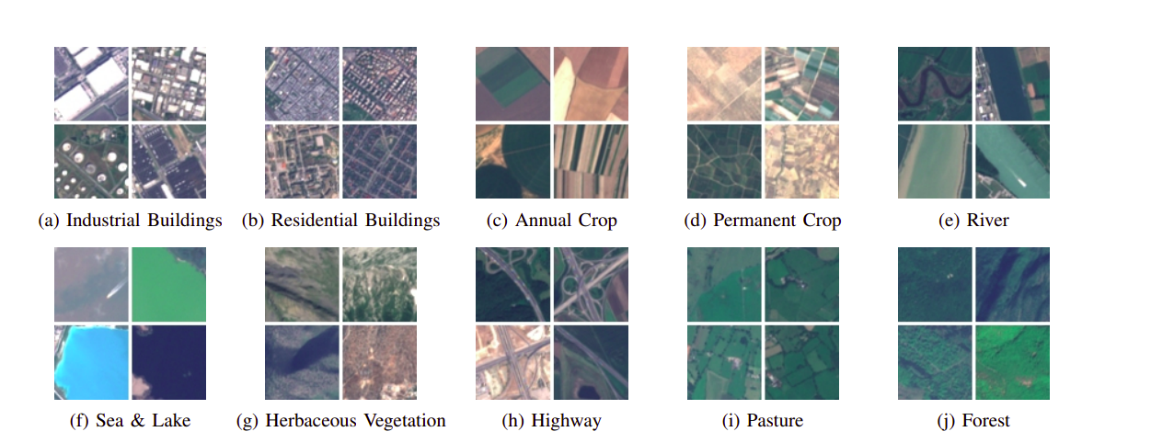
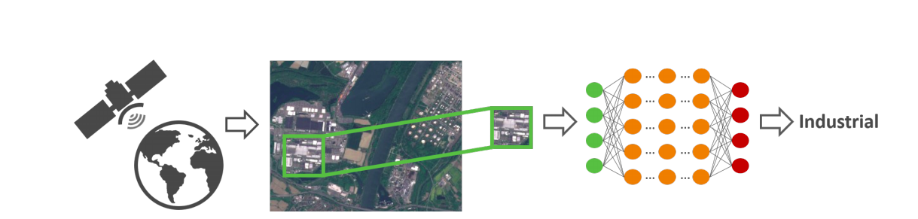
Dataset- examples
Distributed over 34 european countries.
Each class contains 2000 to 3000 images.
We split the dataset in training set and testing set in (80/20) ratio.
We apply stratified shuffle split to maintain class Proportions.
Image data generator Keras for image augmentation.

Slide 5
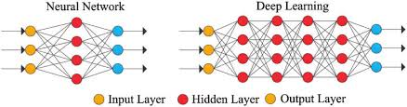
Deep learning
Deep learning is a branch of machine learning which is based on artificial neural networks, as neural network is going to mimic the human brain so deep learning is also a kind of mimic of human brain. It uses multi layer neural networks in order to fit complex mathematical functions
For example, in image processing, lower layers may identify edges, while higher layers may identify the concepts relevant to a human such as digits or letters or faces.

Slide 6
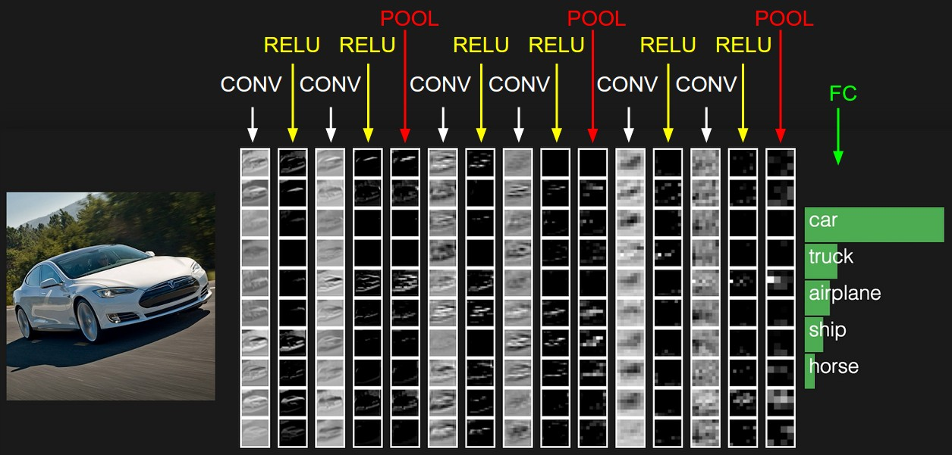
CNN description
A Convolutional Neural Network (ConvNet/CNN) is a Deep Learning algorithm which can take in an input image, assign importance (learnable weights and biases) to various aspects/objects in the image and be able to differentiate one from the other.
As we described above, a simple ConvNet is a sequence of layers, and every layer of a ConvNet transforms one volume of activations to another through a differentiable function. We use three main types of layers to build ConvNet architectures: Convolutional Layer, Pooling Layer, and Fully-Connected Layer (exactly as seen in regular Neural Networks). We will stack these layers to form a full ConvNet architecture.

Slide 7
Why cnn?
Convolutional Neural Networks (CNNs) is the most popular neural network model being used for image classification problem.
Instead of a fully connected network of weights from each pixel, a CNN has just enough weights to look at a small patch of the image.
Dimensionality reduction is achieved using a sliding window with a size less than that of the input matrix.
Images are huge amount data and dimensionality reduction helps as it reduces the number of weights we need to optimize .
The beauty of the CNN is that the number of parameters is independent of the size of the original image

Slide 8
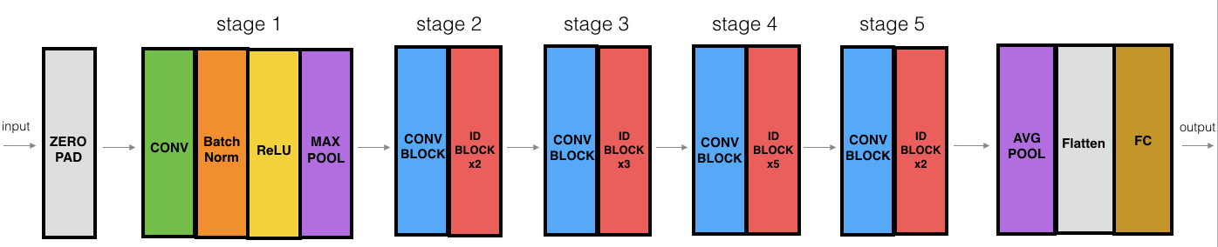
Resnet-50
ResNet-50 is a pre-trained Deep Learning model for image classification of the Convolutional Neural Network.
ResNet-50 is 50 layers deep and is trained on a million images of 1000 categories from the ImageNet database.
Furthermore the model has over 23 million trainable parameters, which indicates a deep architecture that makes it better for image recognition.

Slide 9
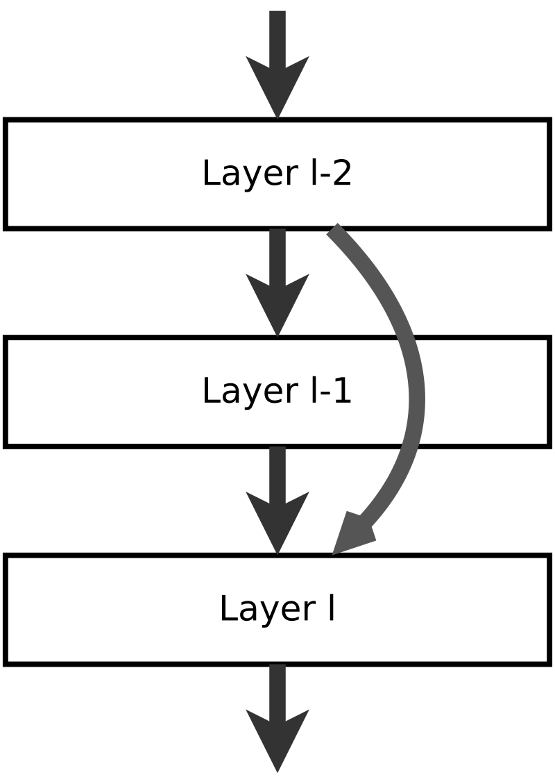
ResNet stands for Residual Network and is characterized by its identity connections.
Identity connections takes the input directly to the end of each residual block.
The ResNet-50 model consists of 5 stages each with a residual block. Each residual block has 3 layers with both 1*1 and 3*3 convolutions.
In this network, each layer feeds into the next layer and directly into the layers about 2–3 hops away, called identity connections.

Slide 10
Resnet-50 implementation and training
Inbuilt resnet50 model in keras was used.
First the dense layer was pre-trained using early stopping and checkpoint.
The pre-training model ran for 21 epochs as early stopping’s patience was set for 10 epochs.
Then loading the same weights we trained our resnet50 model and ran it for 100 epochs and reduceLronplateau callback was also used in this.

Slide 11
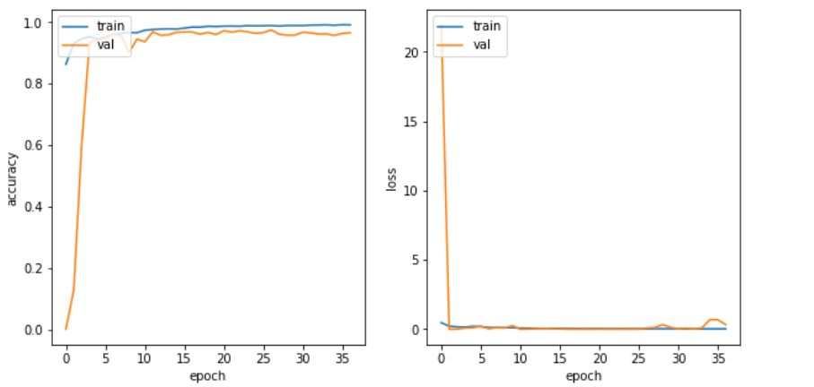
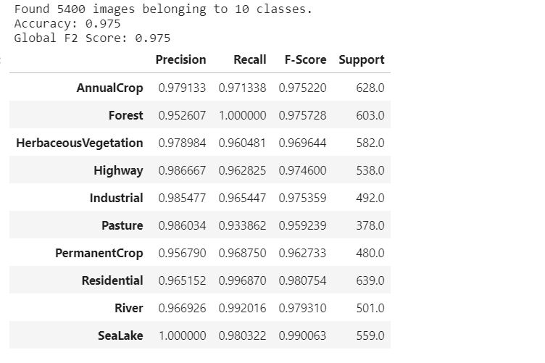
The model ran for 37 epochs as early stopping was used .
The final accuracy came to be 97.5%.

Slide 12
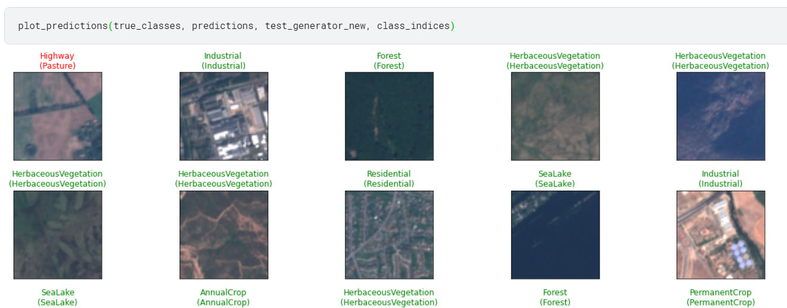
predictions
Model callbacks used are ModelCheckpoint, EarlyStopping and ReduceLROnPlateau.
The optimizer used was Adam optimizer which uses the binary cross entropy loss function.

Slide 13
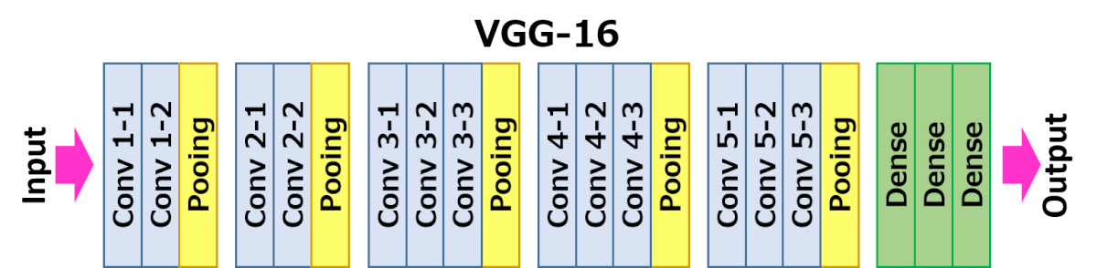
vgg-16
VGG-16 is a pre-trained convolutional neural network that is 16 layers deep.
It is made up of 13 convolution layers and 3 fully connected layers.

Slide 14
Vgg-16 performance and training
Inbuilt vgg-16 in keras was used starting with pre-training the dense layer for transfer learning.
The pre-training ran for 50 epochs and the weights were saved in another model for callback.
Then these weights were used for training the main vgg-16 model which ran for 100 epochs.
Early stopping, checkpoint and reduceLRonplateau callbacks were used.

Slide 15
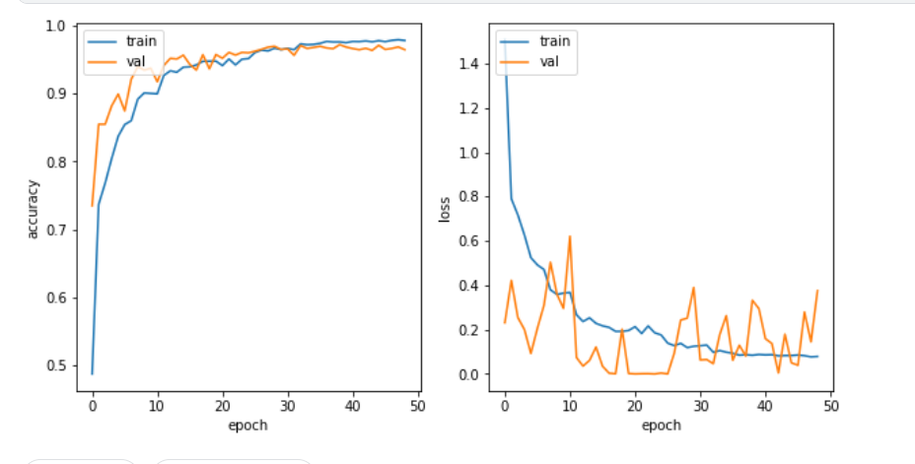
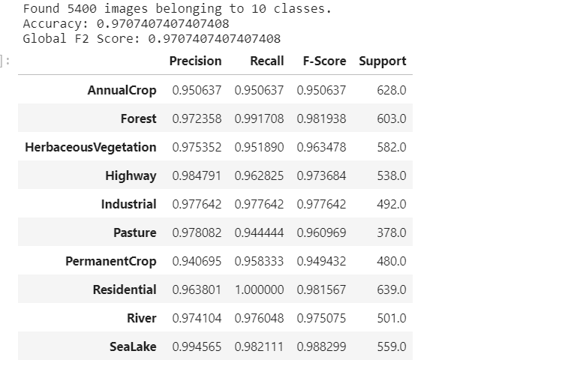
Final accuracy came to be 97.07%.

Slide 16
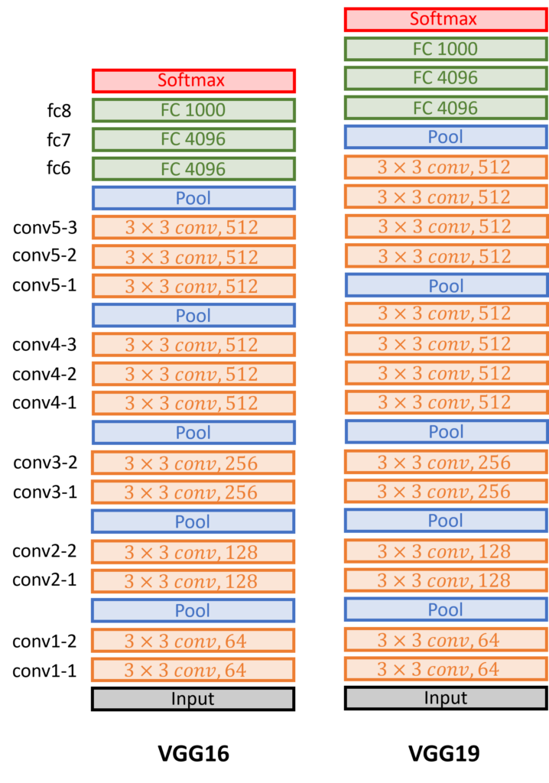
vgg-19
VGG-19 is a pre-trained convolutional neural network that is 19 layers deep.
It is made up of 16 convolution layers and 3 fully connected layers.
Conv layers that are just 3×3
filters with a stride of 1, and with the same padding.
In all Maxpooling layers we will use 2×2 filters with a stride of 2.

Slide 17
Vgg-19 performance and training
Inbuilt vgg-19 in keras was used starting with pre-training the dense layer for transfer learning.
The pre-training ran for 50 epochs and the weights were saved in another model for callback.
Then these weights were used for training the main vgg-16 model which ran for 100 epochs.
Early stopping, checkpoint and reduceLRonplateau callbacks were used.

Slide 18
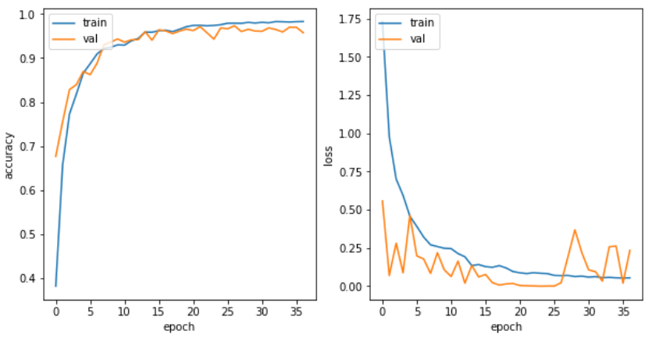
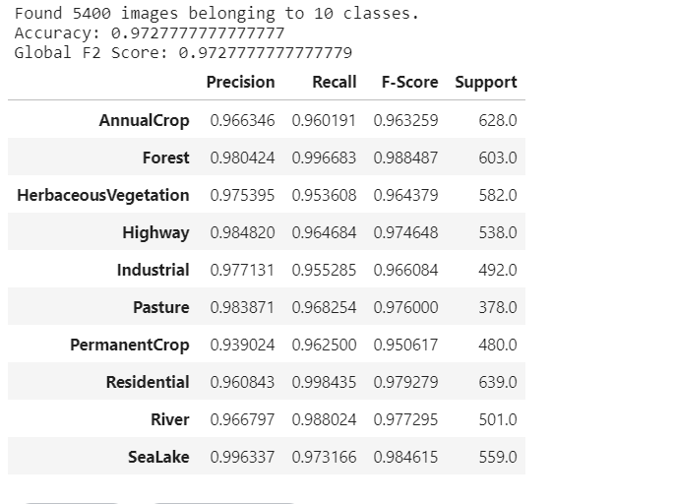
Final accuracy came to be 97.27%. Slightly more than vgg-16 but less than resnet-50.

Slide 19
references
[1] Eurosat: A novel dataset and deep learning benchmark for land use and land cover classification. Patrick Helber, Benjamin Bischke, Andreas Dengel, Damian Borth. IEEE Journal of Selected Topics in Applied Earth Observations and Remote Sensing, 2019.
[2]VERY DEEP CONVOLUTIONAL NETWORKS FOR LARGE-SCALE IMAGE RECOGNITION Karen Simonyan & Andrew Zisserman ,Visual Geometry Group, Department of Engineering Science, University of Oxford

